Slide 1
Introduction to SYS/BIOS
Notes:
1
NEW

Slide 2
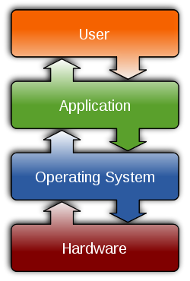
Outline
Intro to SYS/BIOS
Overview
Threads and Scheduling
Creating a BIOS Thread
System Timeline
Real-Time Analysis Tools
Create A New Project
BIOS Configuration (.CFG)
Platforms
For More Info…..
BIOS Threads

Slide 3
Outline
Intro to SYS/BIOS
Overview
Threads and Scheduling
Creating a BIOS Thread
System Timeline
Real-Time Analysis Tools
Create A New Project
BIOS Configuration (.CFG)
Platforms
For More Info…..
BIOS Threads

Slide 4
Need for an Operating System
Input
Input
Input
Input
Input
Input
Input
Process
Output
Event + ISR Device Driver
Data Processing Algorithm
Event + ISR Device Driver
Simple system: single I-P-O is easy to manage
As system complexity increases (multiple threads):
Can they all meet real time ?
Priorities of threads/algos ?
Synchronization of events?
Data sharing/passing ?
2 options: “home-grown” or use existing (SYS/BIOS) (either option requires overhead)
If you choose an existing O/S, what should you consider ?
Is it modular ?
Is it easy to use ?
How much does it cost ?
Is it reliable?
Data sharing/passing ?
What code overhead exists?

Slide 5
SYS/BIOS Overview
Input
Input
Input
Input
Input
Input
Input
Process
Output
Stream
Stream
Queue
Queue
Hwi “Driver”
Swi, Task
Hwi “Driver”
SYS/BIOS
Scheduler
Data Sharing/Passing
Synchronization
Memory Mgmt
SYS/BIOS is a scalable, real-time kernel used in 1000s of systems today:
Pre-emptive Scheduler to design system to meet real-time (including sync/priorities)
Modular – Include only what is needed
API - pre-defined interface for inter-thread communications
Reliable – 1000s of applications have used it for more than 10 years
Footprint – deterministic, small code size, can choose which modules you desire
Cost – free of charge

Slide 6
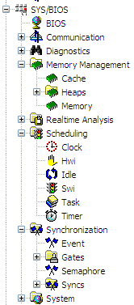
SYS/BIOS Modules & Services
BIOS Configuration
Memory Mgmt
Cache & Heaps
Realtime Analysis
Logs, Loads, Execution Graph
Scheduling
All thread types
Synchronization
Semaphores, Events, Gates
How do you interact with the SYS/BIOS services?

Slide 7
SYS/BIOS Environment
User Code
SYS/BIOS Library
#include <log.h>
func1 { Log_info1(...); }
#include <swi.h>
func2 { Swi_post(…); }
Hwi Swi Task Idle
Stream Mailbox Semaphore
Queue Clock Log HeapMem
HeapBuf HeapMultiBuf
API
SYS/BIOS is a library that contains modules with a particular interface and data structures
Application Program Interfaces (API) define the interactions (methods) with a module and data structures (objects)
Objects - are structures that define the state of a component
Pointers to objects are called handles
Object based programming offers:
Better encapsulation and abstraction
Multiple instance ability
pointer
handle
structure….
element1
element2
…
object

Slide 8
Definitions / Vocabulary
In this workshop, we’ll be using these terms often:
Real-time System
Where processing must keep up with the rate of I/O
Function
Sequence of program instructions that produce a given result
Thread
Function that executes within a specific context (regs, stack, PRIORITY)
API
Application Programming Interface – “methods” for interacting with library routines and data objects

Slide 9
RTOS vs GP/OS
 | GP/OS (e.g. Linux) | RTOS (e.g. SYS/BIOS)
Scope | General | Specific
Size | Large: 5M-50M | Small: 5K-50K
Event response | 1ms to .1ms | 100 – 10 ns
File management | FAT, etc | FatFS
Dynamic Memory | Yes | Yes
Threads | Processes, pThreads, Ints | Hwi, Swi, Task, Idle
Scheduler | Time Slicing | Preemption
Host Processor | ARM, x86, Power PC | ARM, MSP430, M3, C28x, DSP

Slide 10
Outline
Intro to SYS/BIOS
Overview
Threads and Scheduling
Creating a BIOS Thread
System Timeline
Real-Time Analysis Tools
Create A New Project
BIOS Configuration (.CFG)
Platforms
For More Info…..
BIOS Threads

Slide 11
SYS/BIOS Thread Types
Hwi
Hardware Interrupts
Implements ‘urgent’ part of real-time event
Hardware interrupt triggers ISRs to run
Priorities set by hardware
Swi
Software Interrupts
Performs HWI ‘follow-up’ activity
‘posted’ by software
Periodic (Clock) functions are prioritized as SWIs
Up to 32 priority levels (16 on C28x)
Priority
Task
Tasks
Runs programs concurrently under separate contexts
Usually enabled to run by posting a ‘semaphore’ (a task signaling mechanism)
Up to 32 priority levels (16 on C28x)
Idle
Background
Multiple Idle functions
Runs as an infinite loop (like traditional while(1) loop)
Single priority level
Notes:
Using Clock Fxns in a Task-based video system is not really recommended because Clock Functions will ALWAYS have a higher priority than TSKs because periodic functions s are prioritized as Swis.

Slide 12
Hwi’s Signaling Swi/Task
INTx
New paradigm: “Hwi (ISR) handles URGENT activity, then posts follow-up thread”
Hwi:
urgent code
Swi_post();
[OR]
Semaphore_post();
Swi (or Task)
ints disabled
rather than all this time
Hwi
Fast response to interrupts
Minimal context switching
High priority only
Can post Swi
Use for urgent code only – then post follow up activity
Swi
Latency in response time
Context switch performed
Selectable priority levels
Can post another Swi
Execution managed by scheduler
Notes:
When you’re looking at a scheduler, it needs to be able to handle two different types of interrupts: hardware and software.
Hardware needs to run NOW, minimum latency, high priority. These tasks are typically short.
Software is not so time critical, and may take longer to complete.
Shown above we can see a hardware interrupt that posts a software interrupt. Let’s say the hardware interrupt determines the frame and re-programs the DMA. The software interrupt processes the filter and keys off the output process.

Slide 13
Swi’s and Tasks
Swi
Swi_post (Swi);
Task
Semaphore_post (Sem);
start
Semaphore_pend
System Stack
(Hwi/Swi)
Pause
“run to
completion”
(blocked state)
start
Private Stack
(Task)
end
end
Similar to hardware interrupt, but triggered when posted
All Swi’s share system software stack with Hwi’s
Unblocking triggers execution (also could be mailbox, events, etc.)
Each Task has its own stack, which allows them to pause (i.e. block)
Topology: prologue, loop, epilogue…

Slide 14
Outline
Intro to SYS/BIOS
Overview
Threads and Scheduling
Creating a BIOS Thread
System Timeline
Real-Time Analysis Tools
Create A New Project
BIOS Configuration (.CFG)
Platforms
For More Info…..
BIOS Threads

Slide 15
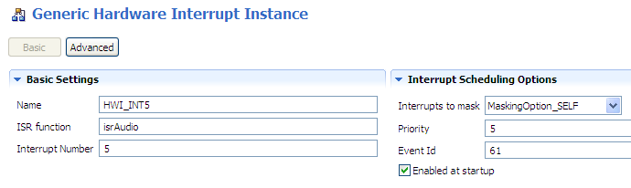
Thread (Object) Creation in BIOS
Users can create threads (BIOS resources or “objects”):
Statically (via the GUI or .cfg script)
Dynamically (via C code) – more details in the “dynamic” chapter
BIOS doesn’t care – but you might…
Dynamic (C Code)
#include <ti/sysbios/hal/Hwi.h>
Hwi_Params hwiParams; Hwi_Params_init(&hwiParams);
hwiParams.eventId = 61; Hwi_create(5, isrAudio, &hwiParams, NULL);
Static (GUI or Script)
app.c
var Hwi = xdc.useModule('ti.sysbios.hal.Hwi'); var hwiParams = new Hwi.Params();
hwiParams.eventId = 61;
Hwi.create(5, "&isrAudio", hwiParams);
app.cfg

Slide 16
Outline
Intro to SYS/BIOS
Overview
Threads and Scheduling
Creating a BIOS Thread
System Timeline
Real-Time Analysis Tools
Create A New Project
BIOS Configuration (.CFG)
Platforms
For More Info…..
BIOS Threads

Slide 17
System Timeline
Hardware |  | Software
Reset H/W | BOOT MODE |  | Provided by TI | main.c |  | Provided by TI
Device Reset | Boot Loader |  | BIOS_init() ( _c_int00 ) | System Init Code | BIOS_start() (Provided by TI) | SYS/BIOS Scheduler
RESET – Device is reset, then jumps to bootloader or code entry point (c_int00)
BOOT MODE – runs bootloader (if applicable)
BIOS_init() – configs static BIOS objects, jumps to c_int00 to init Stack Pointer (SP), globals/statics, then calls main()
main()
User initialization
Must execute BIOS_start() to enable BIOS Scheduler & INTs

Slide 18
Outline
Intro to SYS/BIOS
Overview
Threads and Scheduling
Creating a BIOS Thread
System Timeline
Real-Time Analysis Tools
Create A New Project
BIOS Configuration (.CFG)
Platforms
For More Info…..
BIOS Threads

Slide 19
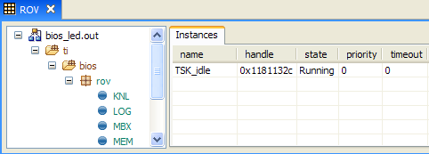
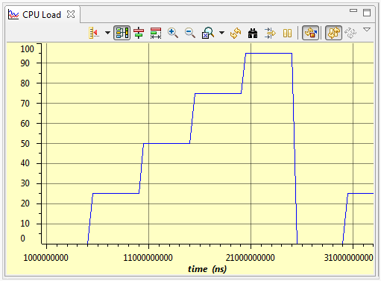
Built-in Real-Time Analysis Tools
Gather data on target (30-40 CPU cycles)
Format data on host (1000s of host PC cycles)
Data gathering does NOT stop target CPU
Halt CPU to see results (stop-time debug)
RunTime Obj View (ROV)
Halt to see results
Displays stats about all threads in system
CPU/Thread Load Graph
Analyze time NOT spent in Idle

Slide 20
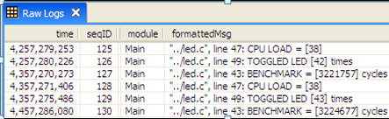
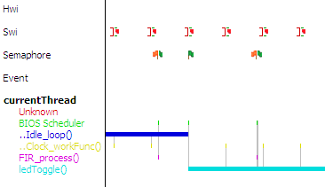
Built-in Real-Time Analysis Tools
Logs
Send DBG Msgs to PC
Data displayed during stop-time
Deterministic, low CPU cycle count
WAY more efficient than traditional printf()
Log_info1(“TOGGLED LED [%u] times”, count);
Execution Graph
View system events down to the CPU cycle…
Calculate benchmarks

Slide 21
Outline
Intro to SYS/BIOS
Overview
Threads and Scheduling
Creating a BIOS Thread
System Timeline
Real-Time Analysis Tools
Create A New Project
BIOS Configuration (.CFG)
Platforms
For More Info…..
BIOS Threads

Slide 22

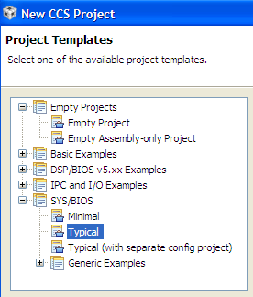
Building a NEW SYS/BIOS Project
Create CCS Project (as normal), then click:
Select a SYS/BIOS Example:
What’s in the project created by “Typical”?
Paths to SYS/BIOS tools
.CFG file (app.cfg) that contains “typical” configuration for static objects (e.g. Swi, Task…)
Source files (main.c) that contains appropriate #includes of header files

Slide 23
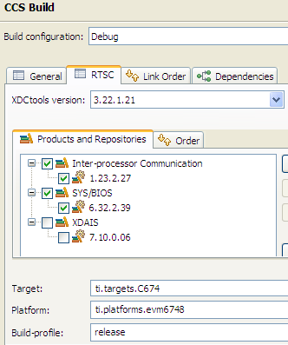
SYS/BIOS Project Settings
Select versions for XDC, IPC, SYS/BIOS, xDAIS
Select “Platform” file (similar to the .tcf seed file for memory)

Slide 24
Outline
Intro to SYS/BIOS
Overview
Threads and Scheduling
Creating a BIOS Thread
System Timeline
Real-Time Analysis Tools
Create A New Project
BIOS Configuration (.CFG)
Platforms
For More Info…..
BIOS Threads

Slide 25
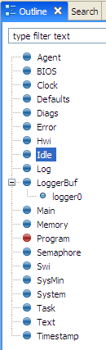
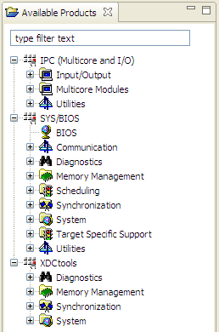
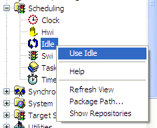
Static BIOS Configuration
Users interact with the CFG file via the GUI – XGCONF:
XGCONF shows “Available Products” – Right-click and “Use Mod”
“Mod” shows up in Outline view – Right-click and “Add New”
All graphical changes in GUI displayed in .cfg source code

Slide 26
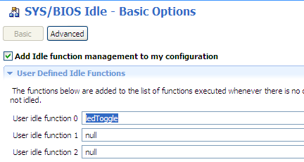
Static Config – .CFG Files
Users interact with the CFG file via the GUI – XGCONF:
When you “Add New”, you get a dialogue box to set up parameters
Two views: “Basic” and “Advanced”

Slide 27
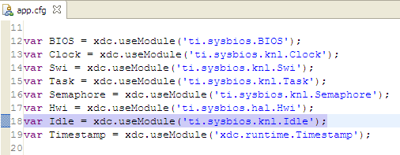
.CFG Files (XDC script)
All changes made to the GUI are reflected with java script in the .CFG file
Click on a module on the right, see the corresponding script in app.cfg

Slide 28
Configuration Build Flow (CFG)
SYS/BIOS – user configures system with CFG file
The rest is “under the hood”
USER
UNDER THE HOOD (TOOLS)
BIOS pkgs (.cfg)
Platform/Target
Build Options
XDC
Configuro
compiler.opt
.cmd
-I
-L
.C
Compiler
Linker
app.out
BIOS modules (like HWI, Clock, Semaphore, etc.) are delivered as RTSC compliant packages
RTSC – Real Time Software Components – Packages that contain libraries and metadata (similar to Java.jar files)
XDC – eXpress DSP Components – set of tools to consume RTSC packages (knows how to read RTSC metadata)
BIOS libs

Slide 29
Outline
Intro to SYS/BIOS
Overview
Threads and Scheduling
Creating a BIOS Thread
System Timeline
Real-Time Analysis Tools
Create A New Project
BIOS Configuration (.CFG)
Platforms
For More Info…..
BIOS Threads

Slide 30
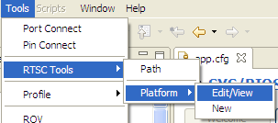
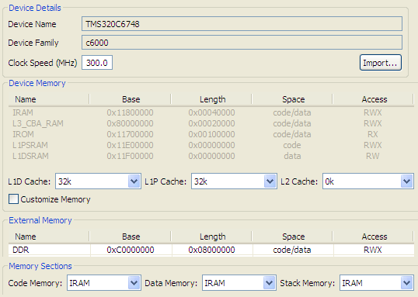
Platform (Memory Config)
Memory Config
Create Internal Memory Segments (e.g. IRAM)
Configure cache
Define External Memory Segments
Section Placement
Can link code, data and stack to any defined mem segment
Custom Platform
Use “Import” button to copy “seed” platform and then customize

Slide 31
Outline
Intro to SYS/BIOS
Overview
Threads and Scheduling
Creating a BIOS Thread
System Timeline
Real-Time Analysis Tools
Create A New Project
BIOS Configuration (.CFG)
Platforms
For More Info…..
BIOS Threads

Slide 32
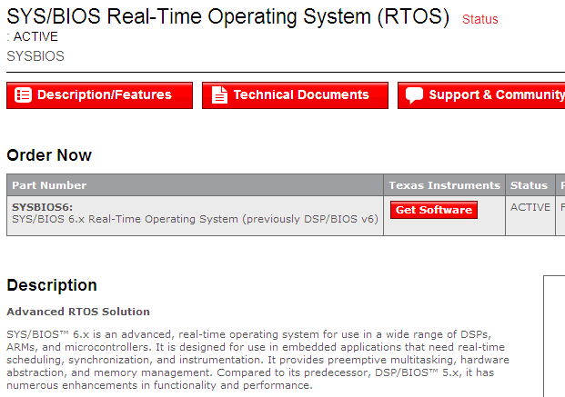
For More Information (1)
SYS/BIOS Product Page (www.ti.com/sysbios).

Slide 33
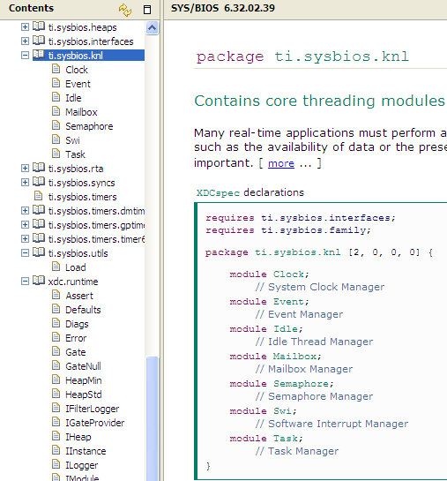
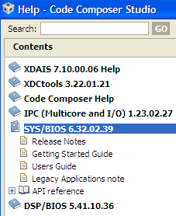
For More Information (2)
CCS Help Contents
User Guides
API Reference (knl)

Slide 34
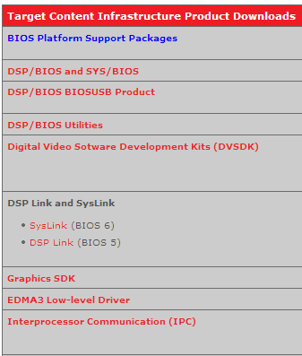
Download Latest Tools
Download Target Content
http://software-dl.ti.com/dsps/dsps_public_sw/sdo_sb/targetcontent/
DSP/BIOS
SYS/BIOS
Utilities
SysLink
DSP Link
IPC
Etc.

Slide 35
Outline
Intro to SYS/BIOS
BIOS Threads
Hardware Interrupts (HWI)
Software Interrupts (SWI)
Tasks (TSK)
Semaphores (SEM)

Slide 36
Hwi Scheduling
Hwi (hi)
Hardware Interrupts
Hwi priorities set by hardware
Fixed number, preemption optional
Hard R/T
Swi
Software Interrupts
Up to 32 priority levels (16 on C28x)
Any number possible, all preemptive
Task
Tasks
Up to 32 priority levels (16 on C28x)
Any number possible, all preemptive
Idle (lo)
Background
Continuous loop
Non-realtime in nature
Soft R/T
Idle events run in sequence when no Hwis are posted
Hwi is ISR with automatic vector table generation + context save/restore
Any Hwi preempts Idle, Hwi may preempt other Hwi if desired

Slide 37
Foreground / Background Scheduling
main()
{ init
while(1)
nonRT }
main() { init BIOS_start() }
Scheduler
Idle nonRT + instrumentation
ISR get buffer process printf()
Hwi get buffer process LOG_info1()
Idle events run in sequence when no Hwis are posted
Hwi is ISR with automatic vector table generation + context save/restore
Any Hwi preempts Idle, Hwi may preempt other Hwi if desired
Which real-time "event" causes the Hwi to execute?

Slide 38
CPU Interrupts from Peripheral (Ex: SPI)
CPU
C O D E C
XRBUF12
XRSR
RRDY=1
“Ready to Read”
SPI_INT
XRBUF11
XRSR
XRDY=1
“Ready to Write”
Peripheral (e.g. SPI on C6678) causes an interrupt to the CPU to indicate “service required”.
This “event” will have an ID (datasheet) and can be tied to a specific CPU interrupt (target specific)
How do we configure SYS/BIOS to respond to this interrupt and call the appropriate ISR?

Slide 39

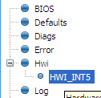
Configuring an Hwi – Statically via GUI
Example:
Tie SPI_INT to the CPU’s HWI₅
1
Use Hwi module (Available Products) , insert new Hwi (Outline View)
Remember, BIOS objects can be created via the GUI, script code or C code (dynamic)
2
Configure Hwi – Event ID, CPU Int #, ISR vector:
To enable INT at startup, check the box
Where do you find the Event Id #?

Slide 40
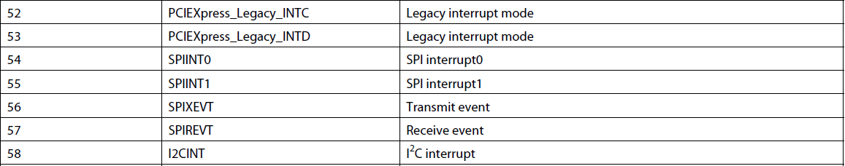
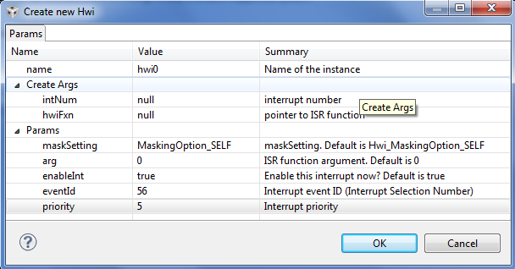
Hardware Event IDs
So, how do you know the names of the interrupt events and their corresponding event numbers?
Look it up (in the datasheet), of course…
Ref: TMS320C6678 datasheet (exerpt):
This example is target-specific for the C6678 DSP. Simply refer to your target’s datasheet for similar info.
What happens in the ISR ?

Slide 41
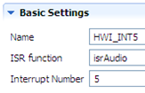
Example ISR (SPI)
Example ISR for SPIXEVT_INT interrupt
isrAudio:
pInBuf[blkCnt] = SPI->RCV; // READ audio sample from SPI
SPI->XMT = pOutBuf[blkCnt] // WRITE audio sample to SPI
blkCnt+=1; // increment blk counter
if( blkCnt >= BUFFSIZE )
{
memcpy(pOut, pIn, Len); // Copy pIn to pOut (Algo)
blkCnt = 0; // reset blkCnt for new buf’s
pingPong ^= 1; // PING/PONG buffer boolean
}
Can one interrupt preempt another?

Slide 42
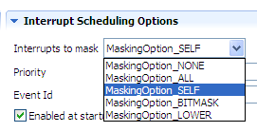
Enabling Preemption of Hwi
Default mask is “SELF” – which means all other Hwi’s can pre-empt except for itself
Can choose other masking options as required:
ALL: Best choice if ISR is short & fast
NONE: Dangerous – make sure ISR code is re-entrant
BITMASK: Allows custom mask
LOWER: Masks any interrupt(s) with lower priority (ARM)
Notes:
Note: See .s62 file for vector table. For DSP (C6000, C28x, any NON-ARM device), “LOWER” compiles to “SELF” – so it is not supported. However, “LOWER” does make sense for ARM devices (M3, Cortex-A8, etc)

Slide 43
SYS/BIOS Hwi APIs
Other useful Hwi APIs:
Hwi_disableInterrupt() Set enable bit = 0
Hwi_enableInterrupt() Set enable bit = 1
Hwi_clearInterrupt() Clear INT flag bit = 0
Hwi_post() Post INT # (in code)
Hwi_disable() Global INTs disable
Hwi_enable() Global INTs enable
Hwi_restore() Global INTs restore
New in SYS/BIOS
Let's move on to SWIs...

Slide 44
Outline
Intro to SYS/BIOS
BIOS Threads
Hardware Interrupts (HWI)
Software Interrupts (SWI)
Tasks (TSK)
Semaphores (SEM)

Slide 45
Swi Scheduling
Hwi (hi)
Hardware Interrupts
Hwi priorities set by hardware
Fixed number, preemption optional
Hard R/T
Swi
Software Interrupts
Up to 32 priority levels (16 on C28x)
Any number possible, all preemptive
Task
Tasks
Up to 32 priority levels (16 on C28x)
Any number possible, all preemptive
Idle (lo)
Background
Continuous loop
Non-realtime in nature
Soft R/T
SYS/BIOS provides for Hwi and Swi management
SYS/BIOS allows the Hwi to post a Swi to the ready queue

Slide 46
Hardware and Software Interrupt System
Execution flow for flexible real-time systems:
INT !
Hard R/T Process
Post Swi
Cleanup, RET
Hwi
SWI Ready
Continue Processing ...
Swi
Hwi
Fast response to INTs
Min context switching
High priority for CPU
Limited # of Hwi possible
isrAudio:
Swi
Latency in response time
Context switch
Selectable priority levels
Scheduler manages execution
*buf++ = *XBUF;
cnt++;
if (cnt >= BLKSZ) {
Swi_post(swiFir);
count = 0;
pingPong ^= 1;
}
SYS/BIOS provides for Hwi and Swi management
SYS/BIOS allows the Hwi to post a Swi to the ready queue
Scheduling SWIs...

Slide 47
Scheduling Rules
Swi_post(swi_b)
Highest Priority
Hwi
swi_b (p2)
swi_a (p1)
Legend
Idle
Running
Ready
Lowest Priority
time
Swi_post(mySwi) : Unconditionally post a software interrupt (in the ready state)
If a higher priority thread becomes ready, the running thread is preempted
Swi priorities from 1 to 32 (C28x has 16)
Automatic context switch (uses system stack)
What if the SWIs are at the same priority?
Notes:
This diagram shows two task of unequal priority. First the lower priority task is running and is interrupted by an ISR which then runs a higher priority task. The lower priority task running is preempted and rescheduled. After the higher priority task is completed it prompts the lower priority task to run

Slide 48
Scheduling Rules
Swi_post(swi_b)
Highest Priority
Hwi
swi_b (p1)
swi_a (p1)
Legend
Idle
Running
Ready
Lowest Priority
time
Processes of same priority are scheduled first-in first-out (FIFO)
Having threads at the SAME priority offers certain advantages – such as resource sharing (without conflicts)
How do you configure a SWI?
Notes:
If threads are at the same priority to solve the “resource conflict” problem, this can be dangerous IF someone comes along and changes the priorities. Be careful.

Slide 49
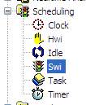

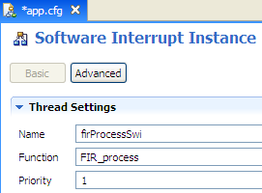
Configuring a Swi – Statically via GUI
Example:
Tie isrAudio() fxn to Swi, use priority 1
1
Use Swi module (Available Products) , insert new Hwi (Outline View)
Remember, BIOS objects can be created via the GUI, script code or C code (dynamic)
2
Configure Swi – Object name, function, priority:
Let's move on to Tasks...
Notes:
Uint32 gie;
…
gie = IRQ_globalDisable();
...
IRQ_globalRestore(gie);

Slide 50
SYS/BIOS Swi APIs
Other useful Swi APIs:
Swi_inc() Post, increment count
Swi_dec() Decrement count, post if 0
Swi_or() Post, OR bit (signature)
Swi_andn() ANDn bit, post if all posted
Swi_getPri() Get any Swi Priority
Swi_enable Global Swi enable
Swi_disable() Global Swi disable
Swi_restore() Global Swi restore
Let's move on to Tasks...

Slide 51
Outline
Intro to SYS/BIOS
BIOS Threads
Hardware Interrupts (HWI)
Software Interrupts (SWI)
Tasks (TSK)
Semaphores (SEM)

Slide 52
Task Scheduling
Hwi (hi)
Hardware Interrupts
Hwi priorities set by hardware
Fixed number, preemption optional
Hard R/T
Swi
Software Interrupts
Up to 32 priority levels (16 on C28x)
Any number possible, all preemptive
Task
Tasks
Up to 32 priority levels (16 on C28x)
Any number possible, all preemptive
Idle (lo)
Background
Continuous loop
Non-realtime in nature
Soft R/T
All Tasks are preempted by all Swi and Hwi
All Swi are preempted by all Hwi
Preemption amongst Hwi is determined by user
In absence of Hwi, Swi, and Task, Idle functions run in loop

Slide 53
Task Code Topology – Pending
Void taskFunction(…)
{
/* Prolog */
while (‘condition’){
Semaphore_pend()
/* Process */
}
/* Epilog */
}
Initialization (runs once only)
Processing loop – (optional: cond)
Wait for resources to be available
Perform desired algo work...
Shutdown (runs once - at most)
Task can encompass three phases of activity
Semaphore can be used to signal resource availability to Task
Semaphore_pend()blocks Task until semaphore (flag) is posted
Let's compare/contrast Swi & Task…

Slide 54
Swi vs. Task
Swi
Task
_post
void mySwi () {
// set local env
*** RUN ***
}
_create
void myTask () {
// Prologue (set Task env)
while(cond){
Semaphore_pend();
*** RUN ***
}
// Epilogue (free env)
}
“Ready” when POSTED
Initial state NOT preserved – must set each time Swi is run
CanNOT block (runs to completion)
Context switch speed (~140c)
All Swi’s share system stack w/Hwi
Use: as follow-up to Hwi and/or when memory size is an absolute premium
“Ready” when CREATED (BIOS_start or dynamic)
P-L-E structure handy for resource creation (P) and deletion (E), initial state preserved
Can block/suspend on semaphore (flag)
Context switch speed (~160c)
Uses its OWN stack to store context
Use: Full-featured sys, CPU w/more speed/mem
Notes:
If you call _pend in a Swi, an assertion causes an abort to occur. I guess you can technically call _pend with a timeout of ZERO, but don’t push it!!

Slide 55
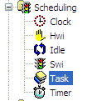

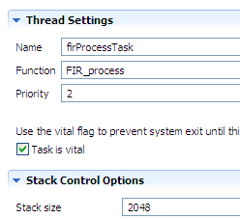
Configuring a Task – Statically via the GUI
Example:
Create firProcessTask, tie to FIR_process(), priority 2
1
Use Task module (Available Products) , insert new Task (Outline View)
Remember, BIOS objects can be created via the GUI, script code or C code (dynamic)
2
Configure Task – Object name, function, priority, stack size:

Slide 56
Task Object Concepts...
myTsk
fxn | *
environ | *
priority | 6
stack | *
name | lpf1
Task object:
Pointer to task function
Priority: changable
Pointer to task’s stack
Stores local variables
Nested function calls
makes blocking possible
Interrupts run on the system stack
Pointer to text name of TSK
Environment: pointer to user defined structure:
struct myEnv
TSK stack
C fxn, eg: bk FIR
inst2
fxn | *
environ | *
priority | 6
stack | *
name | lpf2
struct myEnv
TSK stack
Task_setenv(Task_self(),&myEnv);
hMyEnv = Task_getenv(&myTsk);

Slide 57
Outline
Intro to SYS/BIOS
BIOS Threads
Hardware Interrupts (HWI)
Software Interrupts (SWI)
Tasks (TSK)
Semaphores (SEM)

Slide 58
Semaphore Pend
Semaphore_pend (Sem, timeout);
pend
yes
false
Count > 0
true
Decrement count
timeout = 0
no
timeout expires
Block task
Semaphore Structure:
Non-negative 16-bit counter
Pending queue (FIFO)
SEM
posted
Return
FALSE
Return
TRUE
BIOS_WAIT_FOREVER | -1 | // wait forever
Zero | 0 | // don’t wait
value | timeout | // system ticks
How does _post work?

Slide 59
Semaphore Post
Post
Semaphore_post (Sem);
Task pending on sem?
False
True
Ready first waiting task
Increment count
Semaphore Structure:
Non-negative count
Pending queue (FIFO)
Return
Task switch will occur if higher priority task is made ready
How do you configure a Semaphore?

Slide 60
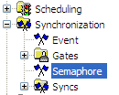

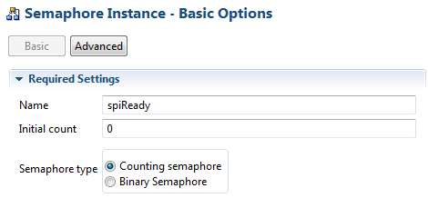
Configuring a Semaphore – Statically via GUI
Example:
Create spiReady , counting
1
Use Semaphore (Available Products) , insert new Semaphore (Outline View)
2
Configure Semaphore – Object name, initial count, type:

Slide 61
SYS/BIOS Semaphore/Task APIs
Other useful Semaphore APIs:
Semaphore_getCount() Get semaphore count
Other useful Task APIs:
Task_sleep () Sleep for N system ticks
Task_yield () Yield to same pri Task
Task_setPri() Set Task priority
Task_getPri() Get Task priority
Task_get/setEnv () Get/set Task Env
Task_enable() Enable Task Mgr
Task_disable() Disable Task Mgr
Task_restore() Restore Task Mgr

Slide 62
Questions?

